Slide 1
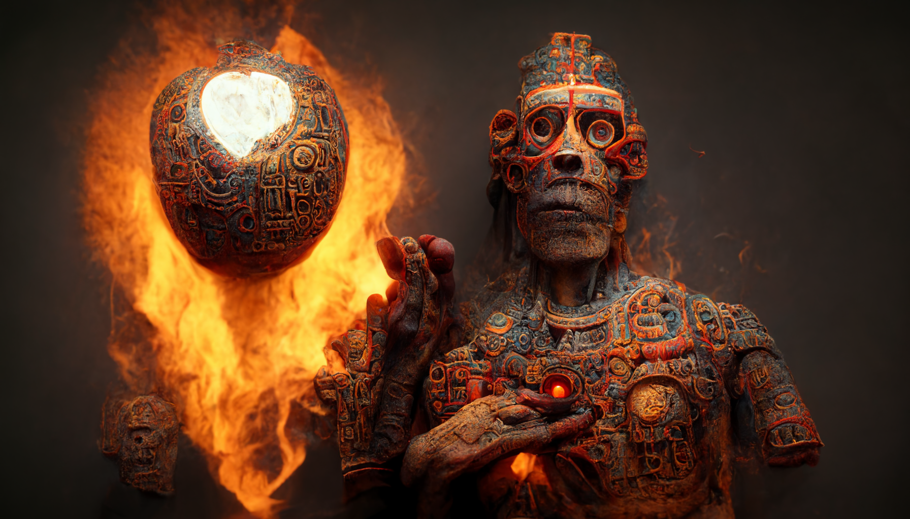
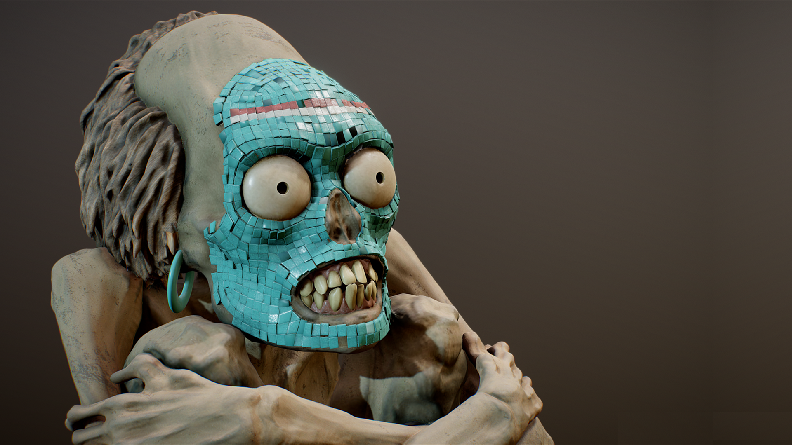
RIP
Harold

Slide 2
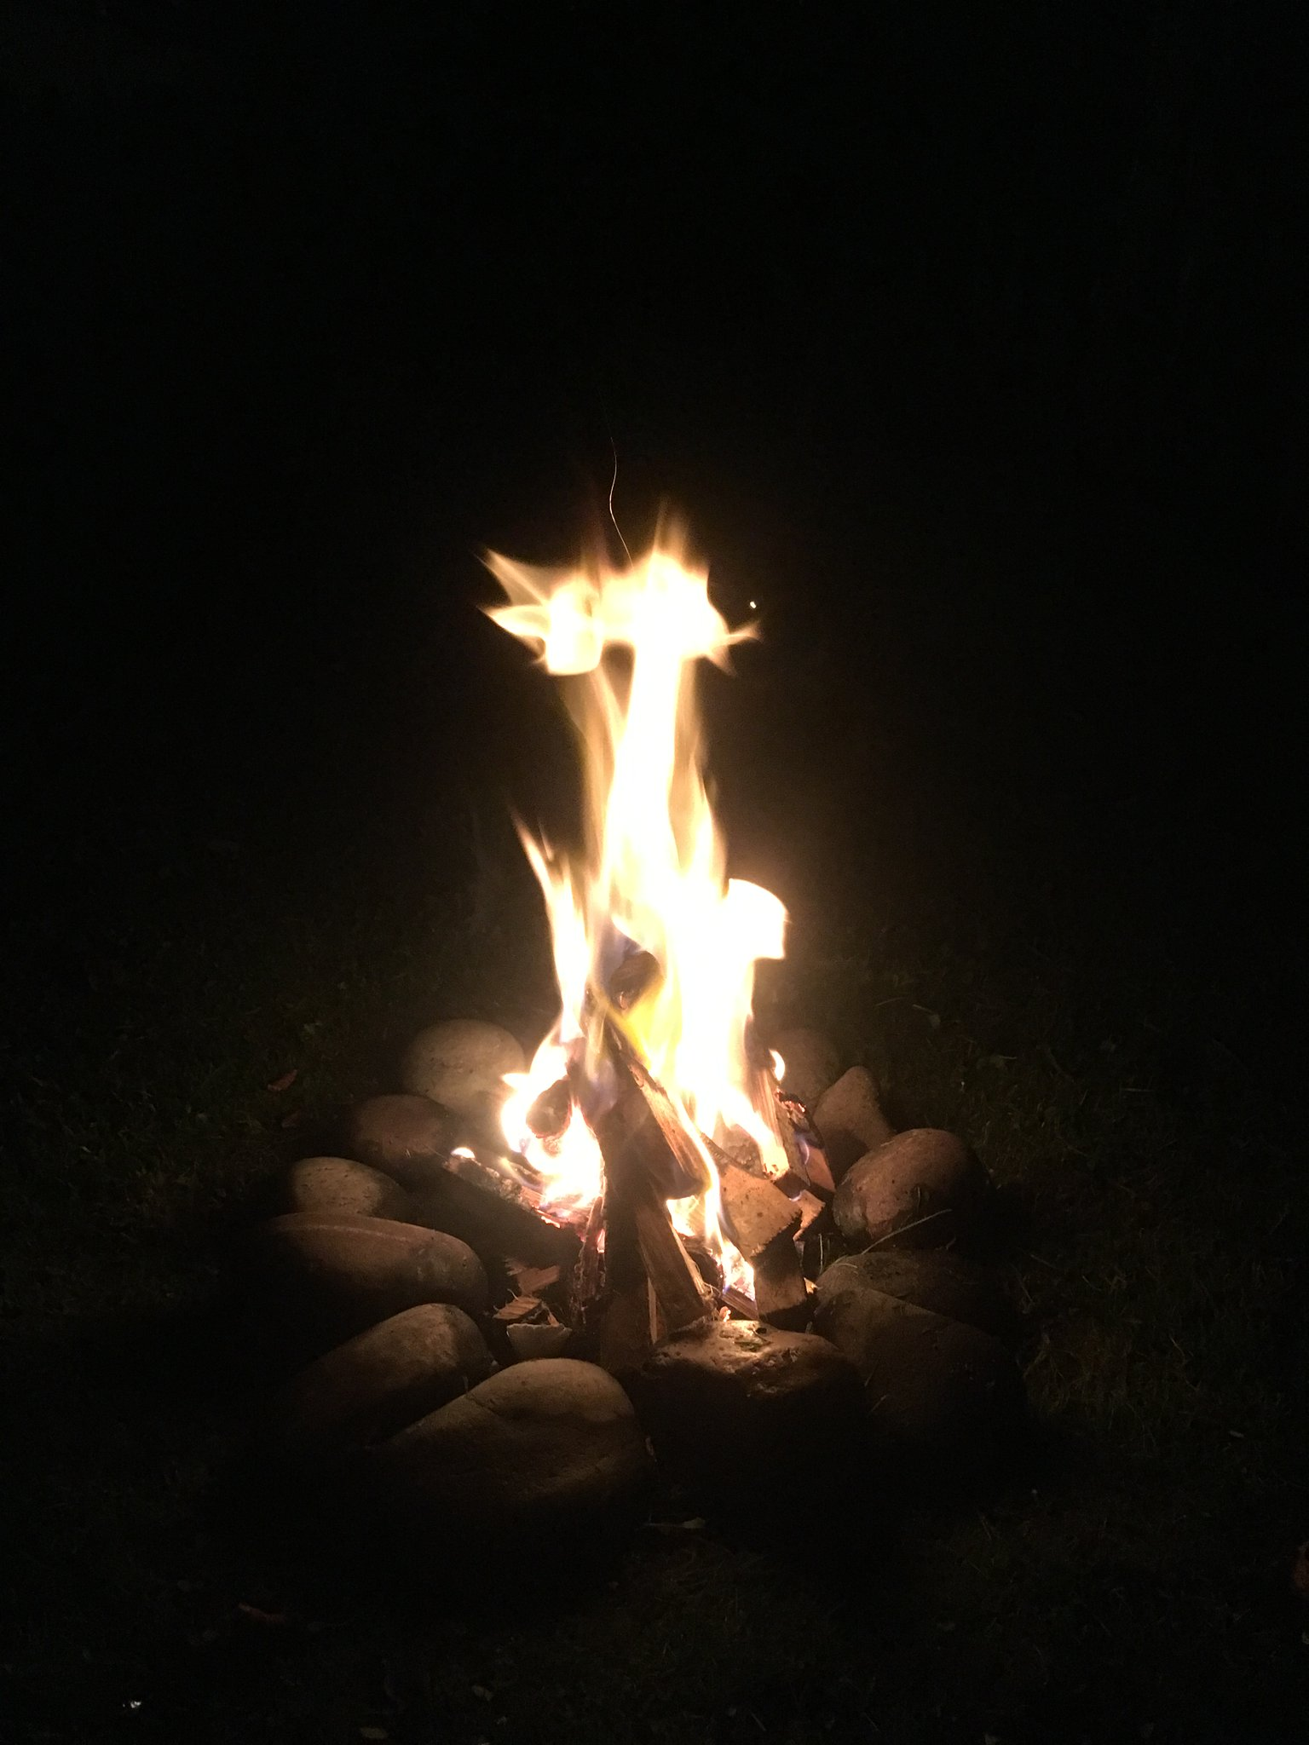

Slide 3
The 6th Sun
Climbing the Totem of Consciousness
Jaguar - survival
Monkey - passion
Turkey - ego
Fish - reason
Eagle - wealth
Quequetzalcoatl - “in whom the serpent rises” Iztac Tonatiuh (White Sun)
Notes:
With Ilancueye: the giants Xelhua, Tenoch, Ulmecatl, Xicalancatl, Mixtecatl, Otomitl

Slide 4
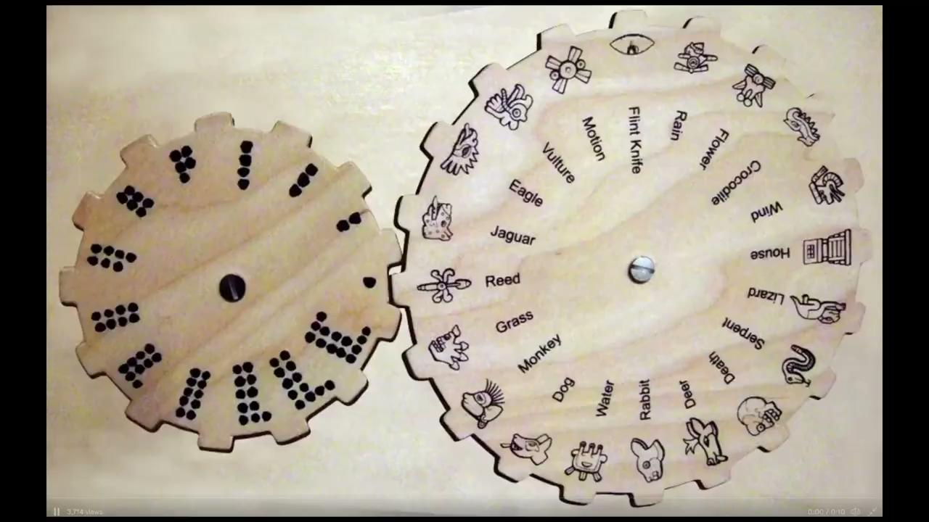
Why 52?
The 20-day group ran simultaneously with another group of 13 numbered days (perhaps not coincidentally the Aztec heaven had 13 layers). This meant that each day had both a name and a number (e.g.: 4-Rabbit), with the latter changing as the calendar rotated. After all possible combinations of names and numbers had been achieved, 260 days had passed. The number 260 has multiple significances: it is the approximate human gestation period, the period between the appearance of Venus, and the length of the Mesoamerican agricultural cycle.
They have often been explained as two engaged, rotating gears, in which the beginning day of the larger 365-day wheel would align with the beginning day of the smaller 260-day cycle every 52 years. This 52-year period constituted a Mesoamerican “century”.
The passing of one 52-year cycle (xiuhmolpilli) to another was marked by the most important religious event of the Aztec world, the New Fire Ceremony, also known, appropriately enough, as the 'Binding of the Years' ceremony. This was when a human sacrifice was made to ensure the renewal of the sun. If the gods were displeased, then there would be no new sun and the world would end.
Wheel13 1440
Wheel20 936
Venus 72
Sun 52
Days 18720

Slide 5
The next Ceremony of the New Fire is on Nov 24 2026

Slide 6
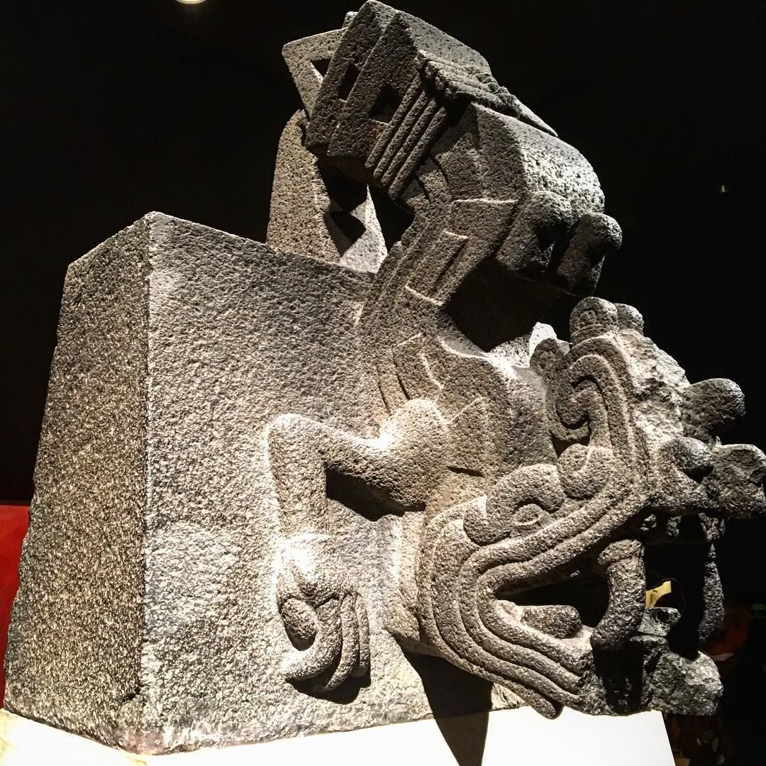
What we’re Told…
Central Mexican people regarded the transition from one fifty-two year period to the next as a time of great danger. It was feared that the sun might not rise again at the start of a new period, and that the world would be destroyed. In order to prevent this, to ensure that the sun would rise again at the start of a new 52-year cycle, Central Mexicans performed a ‘New Fire Ceremony.’

Slide 7
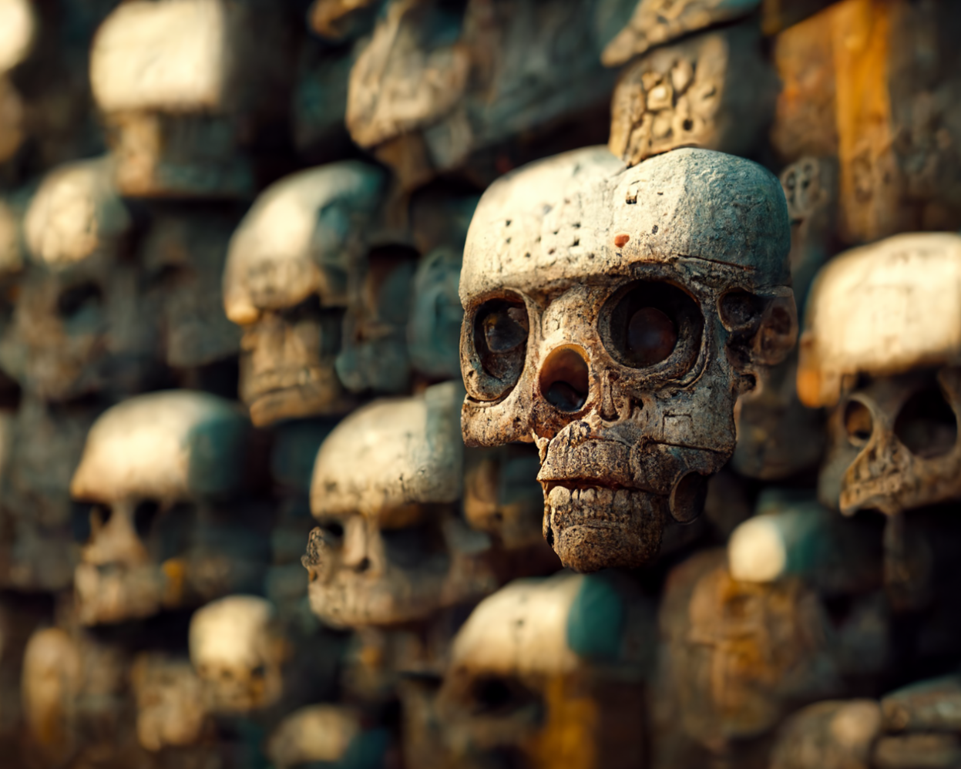
Fire God not so picky about schedule

Slide 8
New Fire Ceremonial Sites
The New Fire ceremonies were an ancient and widespread ritual in Postclassic Central Mexico that the Aztecs appropriated.
Notes:
Tula, Chiconautla, Nonoalco, Tenochtitlan, Cuexcomate, Yautepec, Cerro Huixachtlan

Slide 9
Sacrificial Caste System
Golden Child
Scapegoat
Middle Child
Even enemies of the Aztecs understood their roles as sacrifices to the gods since many also practiced the same type of religion. For many rites, the victims were expected to bless children, greet and cheer passers-by, hear people's petitions to the gods, visit people in their homes, give discourses and lead sacred songs, processions and dances.
The conquistadors Cortés and Alvarado found that some of the sacrificial victims they freed "indignantly rejected [the] offer of release and demanded to be sacrificed"

Slide 10
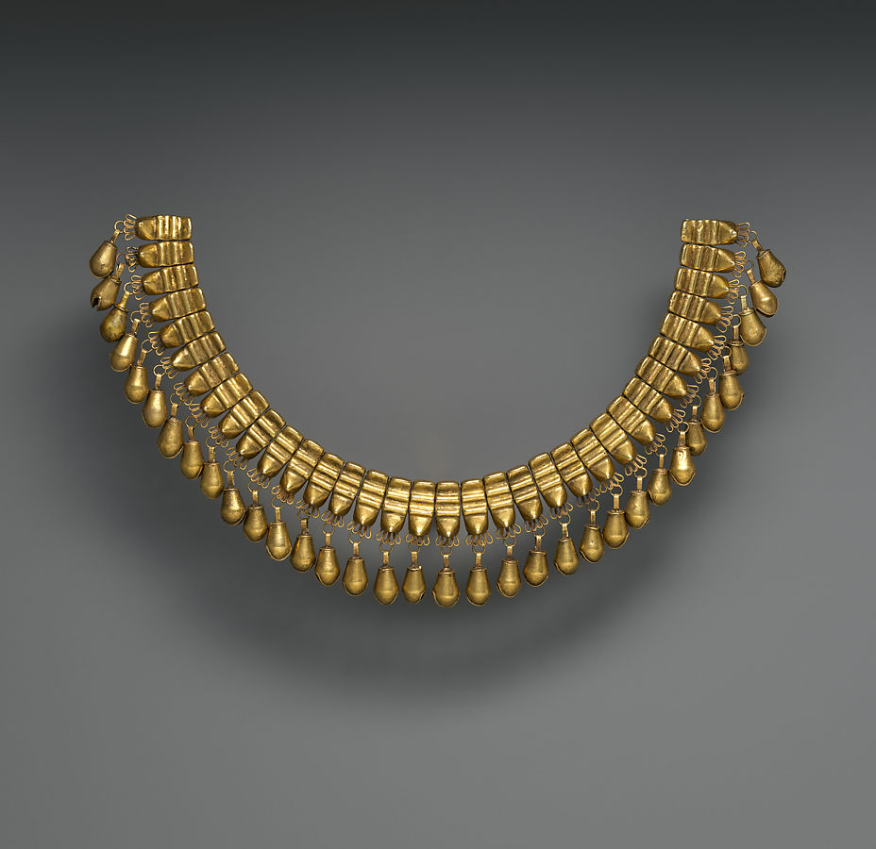
18 Jaguar Molars
Found in pit around sacrifice victim’s neck

Slide 11
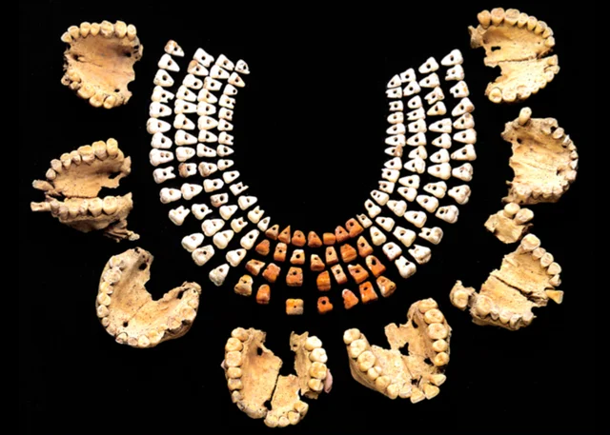
Sacrificial victims found buried beneath the Temple of the Feathered Serpent at Teotihuacan in central Mexico. The victims, wearing necklaces made from real human teeth and jaws, were found with their hands behind their backs, indicating that their wrists had been bound. 150-200 CE [1613x2240]

Slide 12
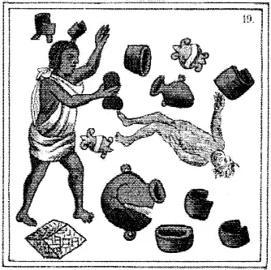
Prep
All of the ceramics people owned were to be thrown out. A thorough cleaning operation was undertaken with the streets being swept, old hearth stones were thrown away and idols were ceremoniously washed and cleansed.
The statues, hewn in either wood or stone, kept in each man’s home and regarded as gods, were all cast into the water.
The pestles and the three hearthstones (upon which the cooking pots rested); and everywhere there was much sweeping—there was sweeping very clean. Rubbish was thrown out; none lay in any of the houses [Sahagún 1950–1982:Book 7:25]

Slide 13
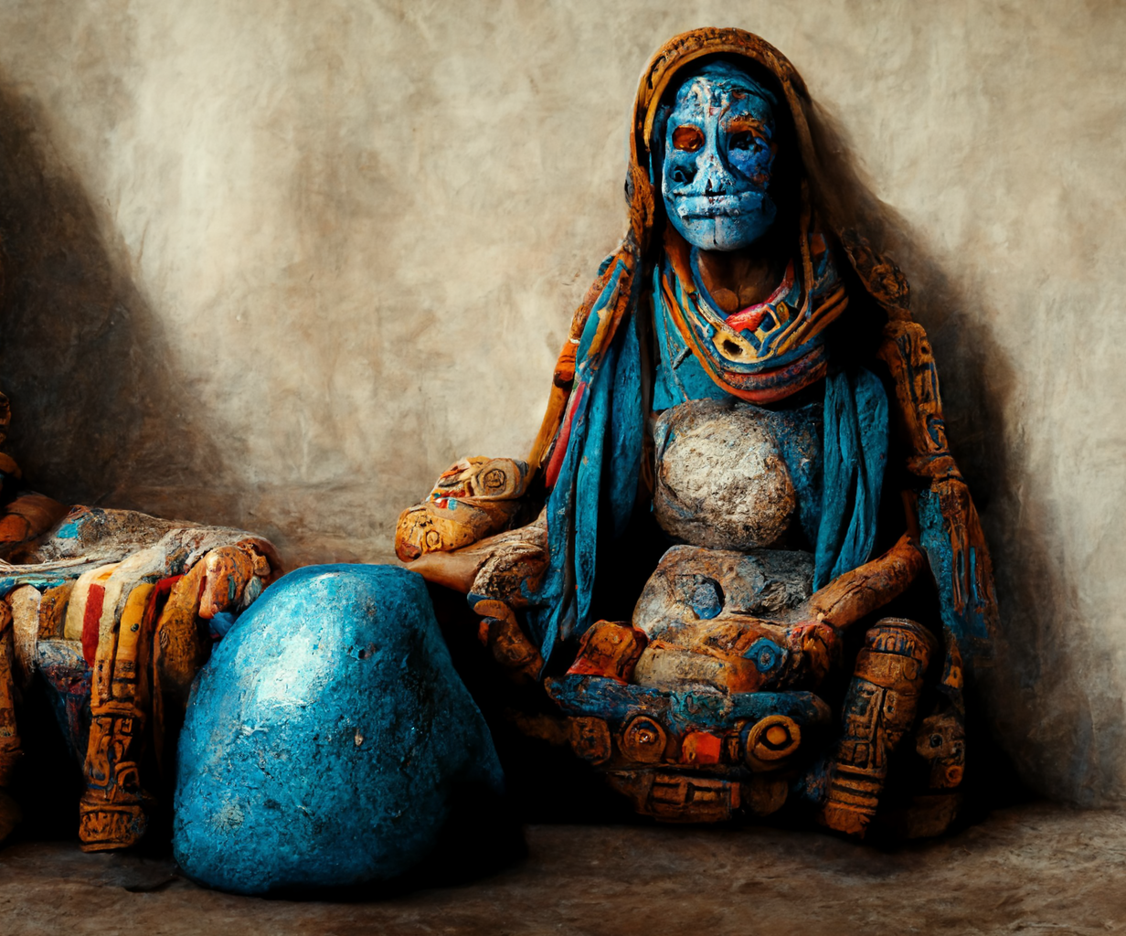
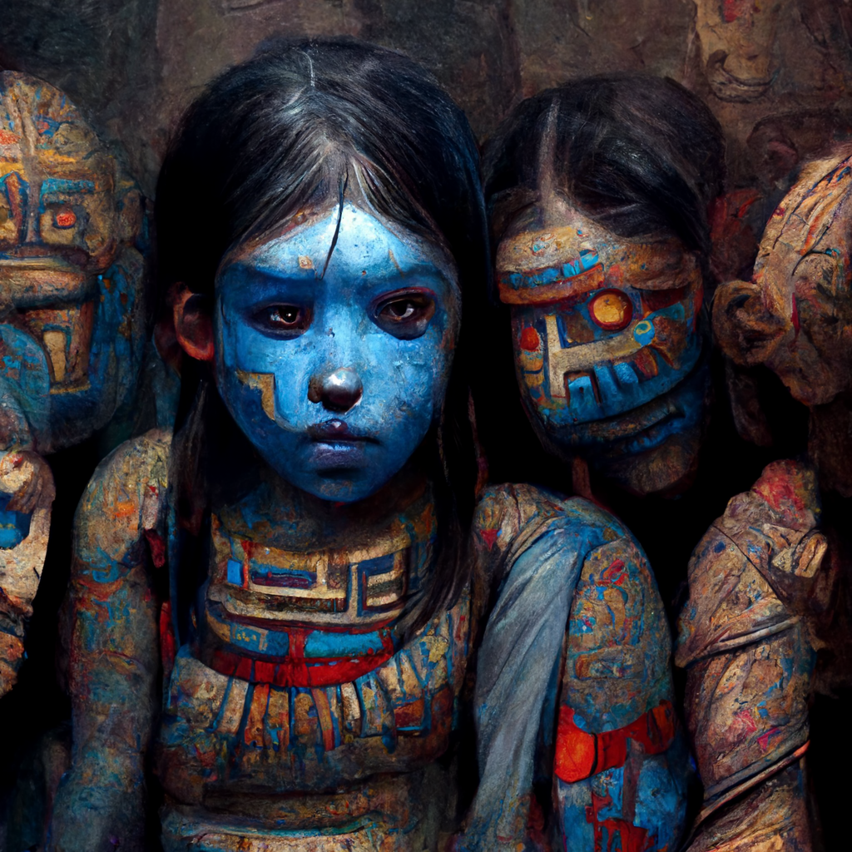
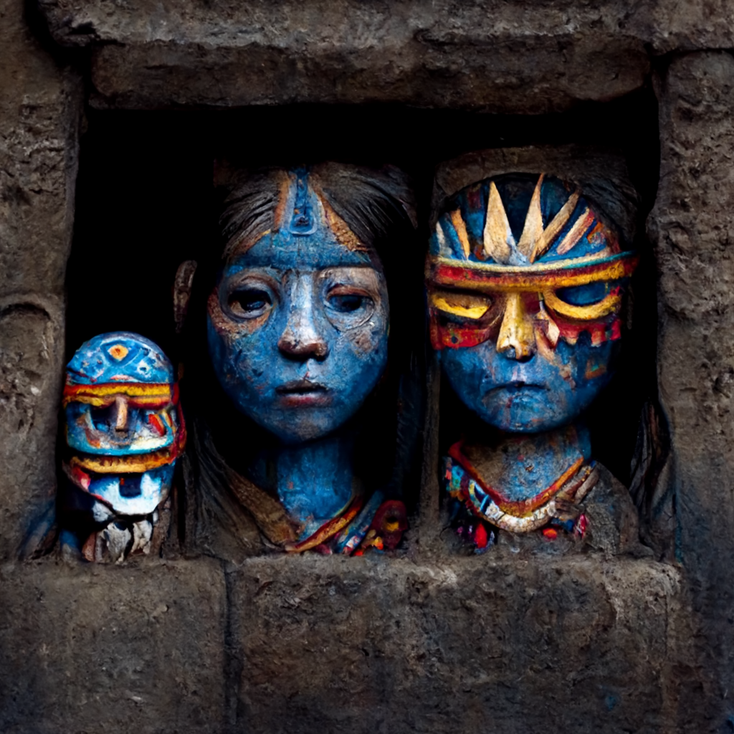
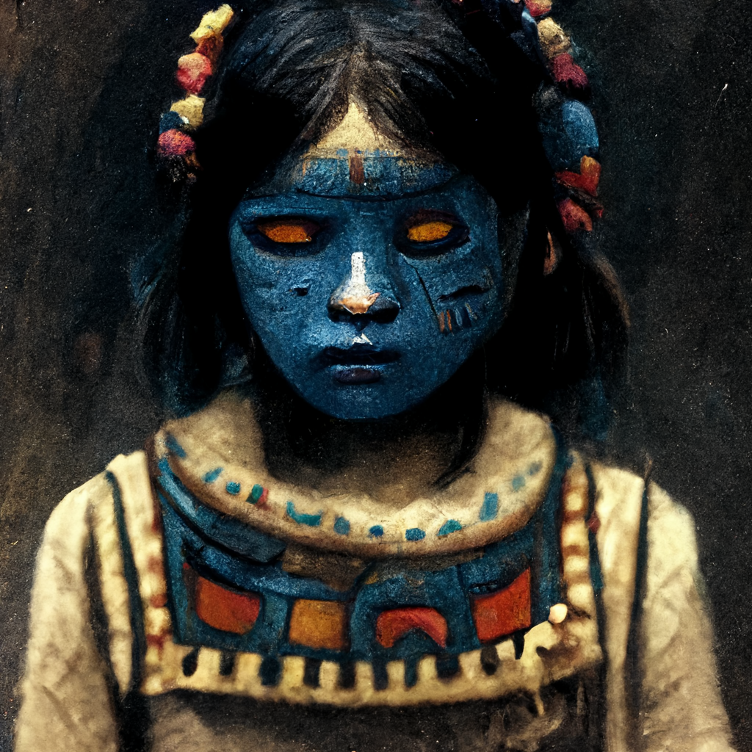
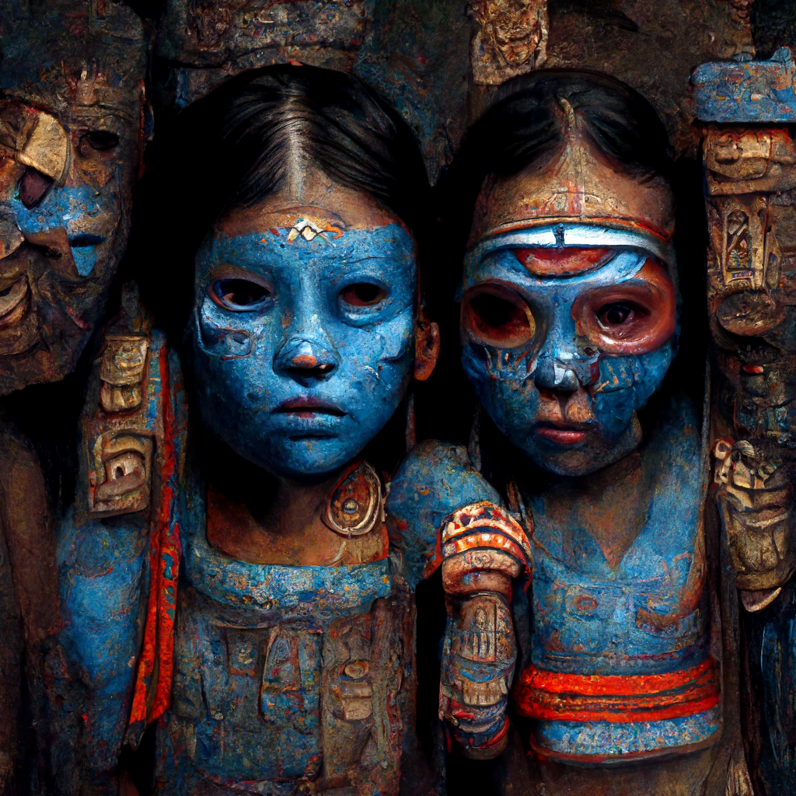
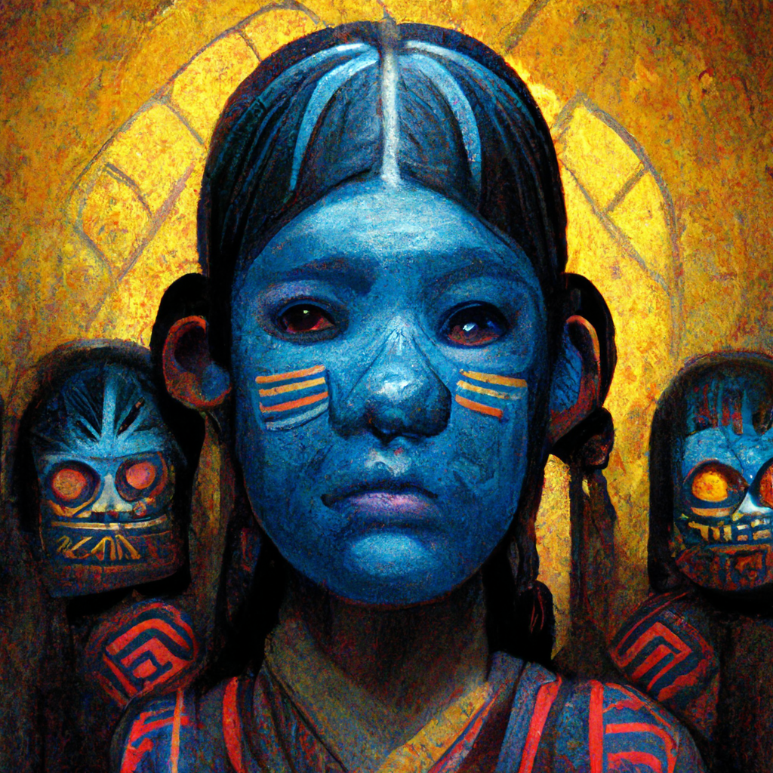
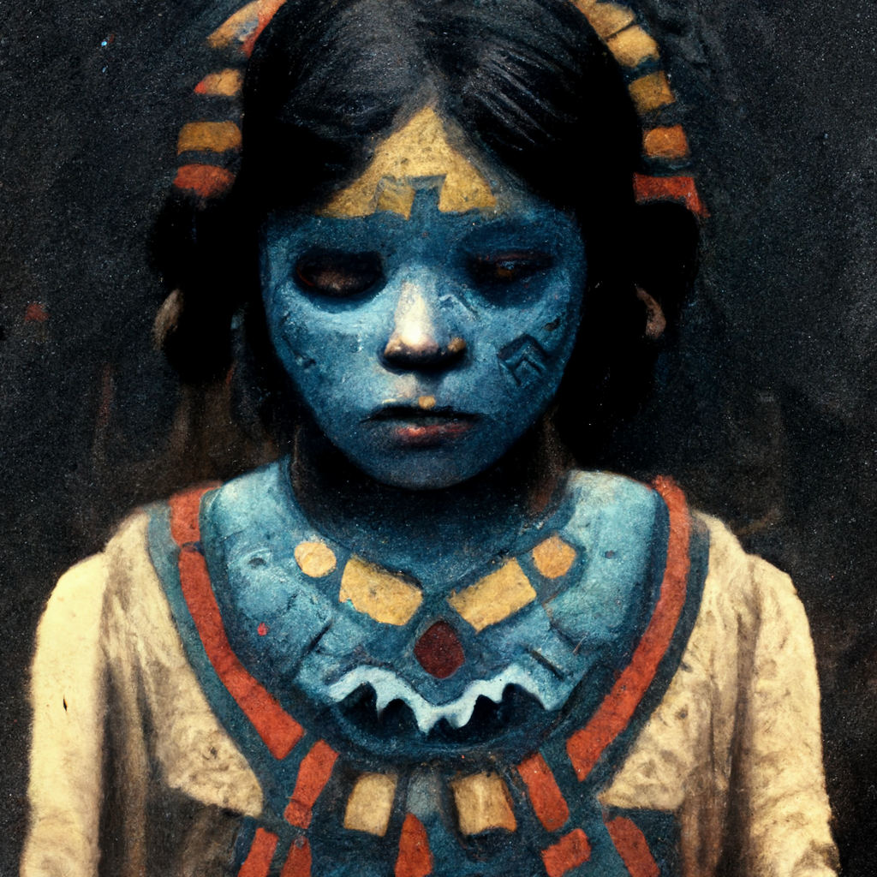
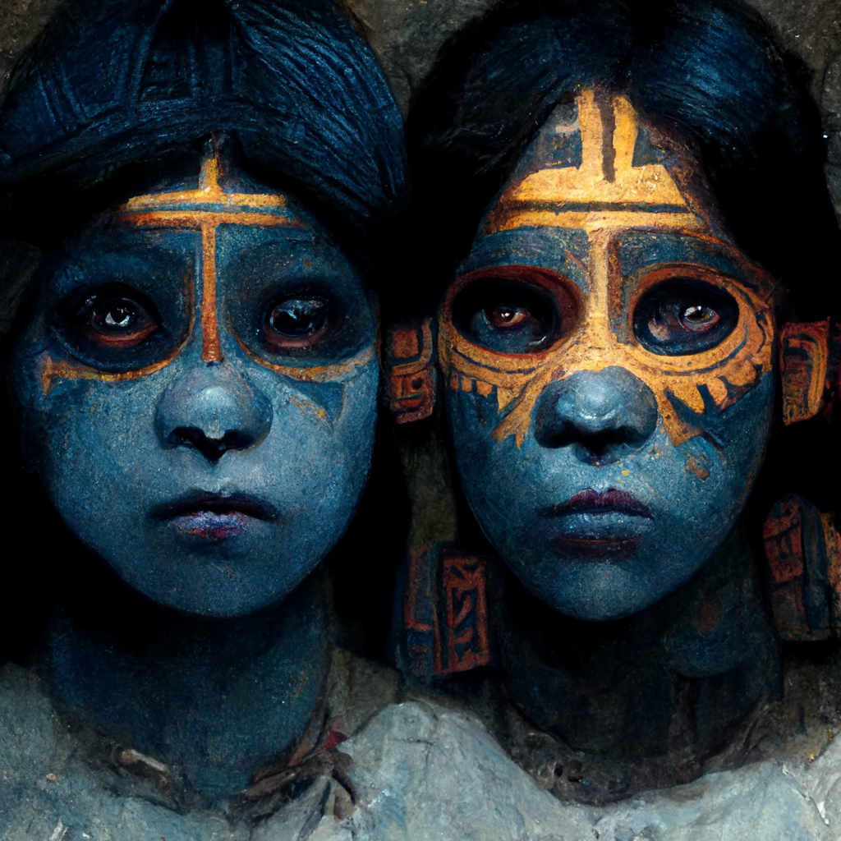
Prep
Pregnant women were locked in granaries and their faces were painted blue in the belief that they would not then turn into monsters during the night. Children also had their faces painted and were kept from sleeping to prevent them turning into mice. Finally, as darkness fell, the populace stopped all activities, climbed the roofs of their homes and waited with a hushed silence and baited breath for what was to come.

Slide 14
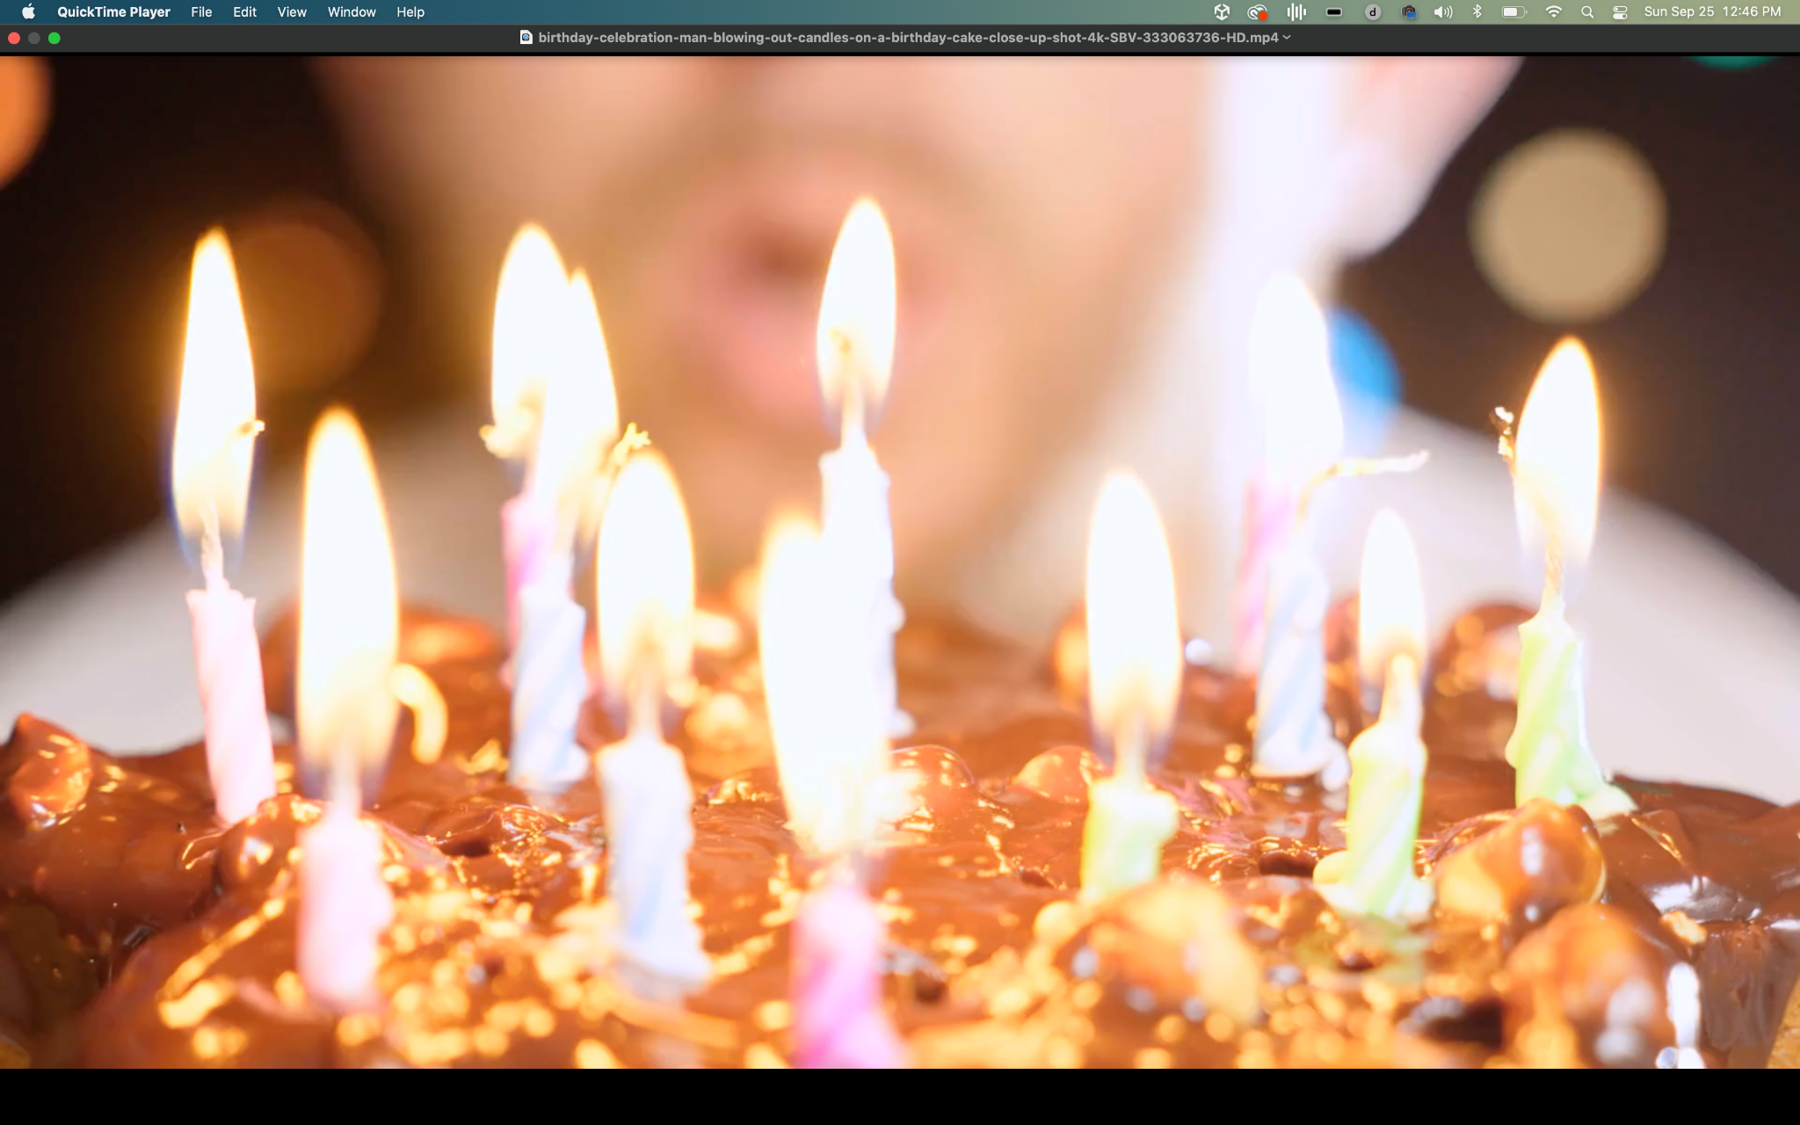
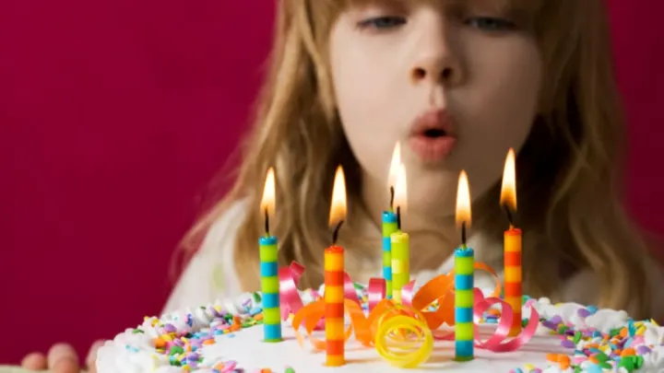
Extinguish all fires for 5 days
First Preparation for the ceremony began with the extinguishing of all fires of any kind, from temples to household hearths. They put out fires everywhere in the country around so that people could wait for the possible end of the world.

Slide 15
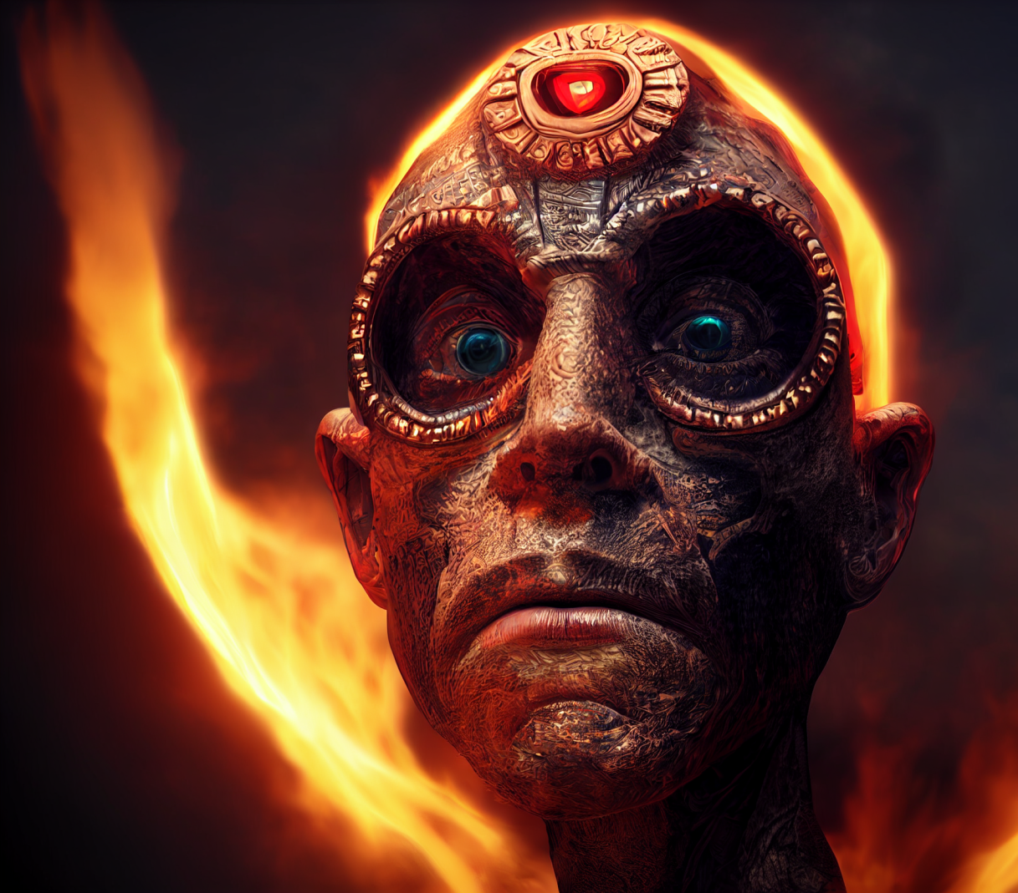
Showtime
On the evening of the last day of the 52-year cycle, priests climbed a hill called Huixachtlan near Culhuacan in the Basin of Mexico, where they watched the stars. When the Pleiades constellation crossed the zenith, this signaled that the sun would rise the next day to start another 52-year calendar round.
Using a fire drill, the priests then started a new fire on the chest of a sacrificial victim. When the flames grew into a full fire, the victim was sacrificed,and his heart was thrown into the fire. Over the course of the day, numerous victims were offered as sacrifices (Motolinía [1951:113] gives the total as 400)

Slide 16
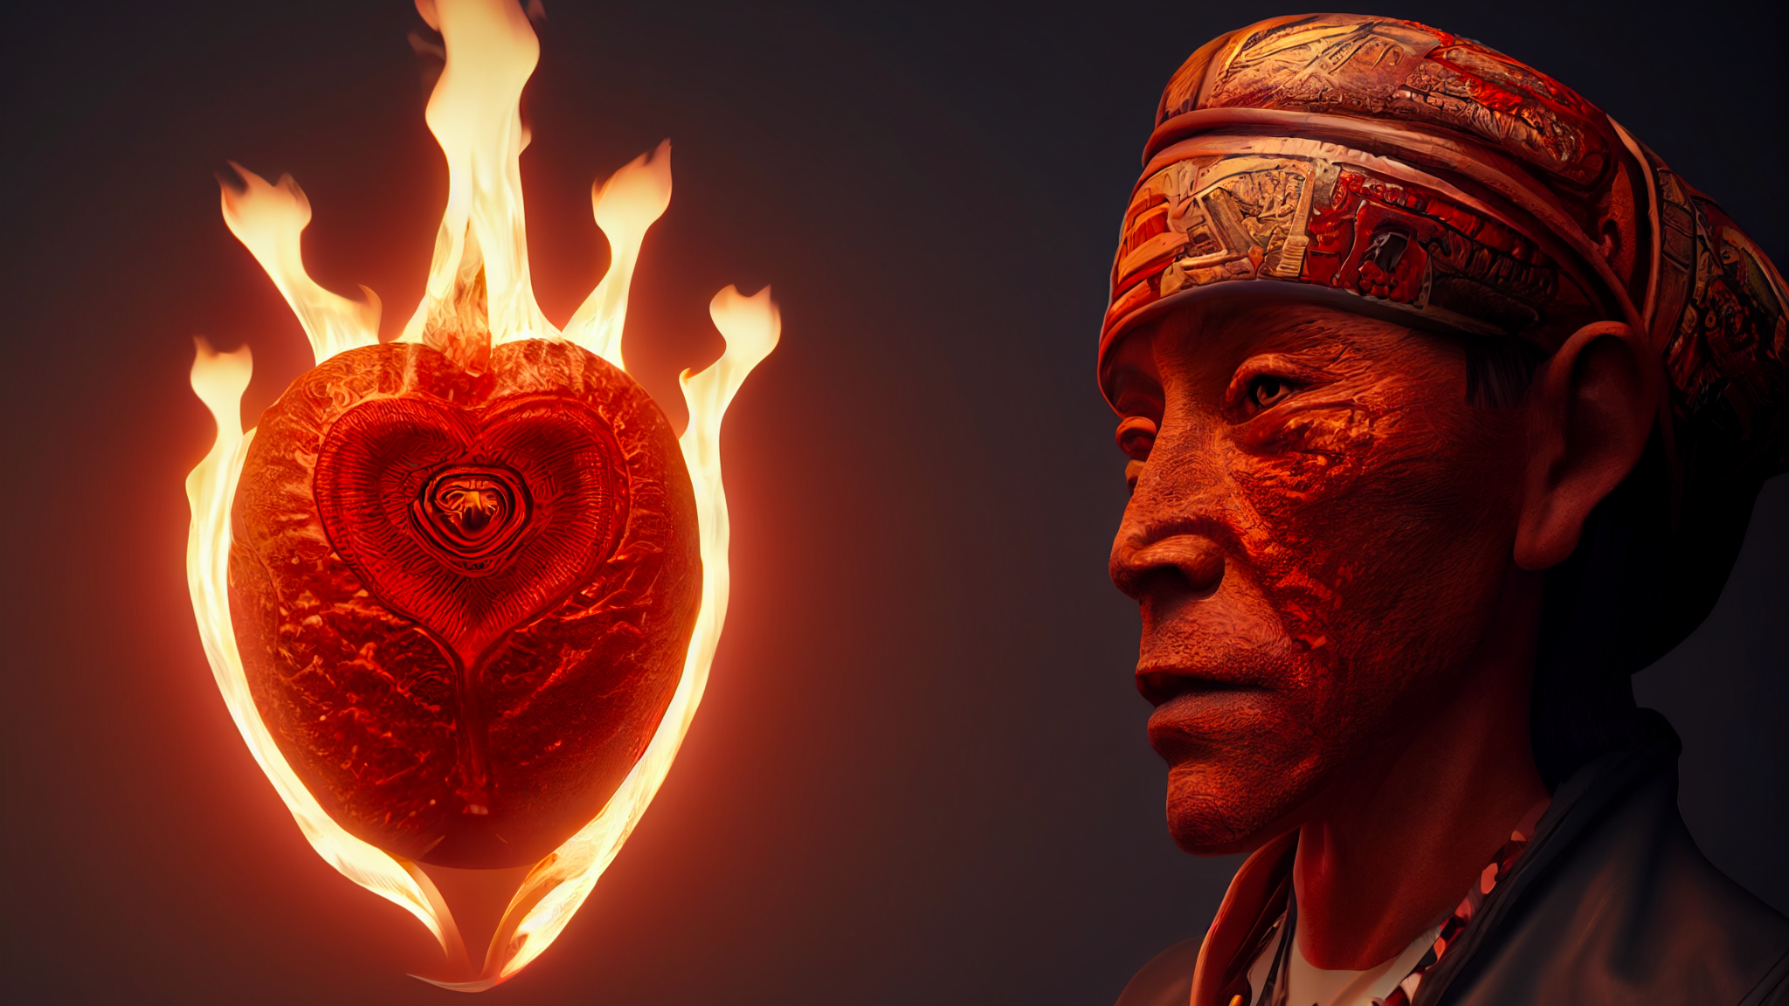

Slide 17
The heart can survive for 10 minutes outside body
With help and an ice box, your heart can survive outside of your body up to 4 hours. Primarily because it gets fed nutrients and because the cold temperature keeps it from wasting energy by beating. Once the heart warms back up, it starts beating normally.

Slide 18
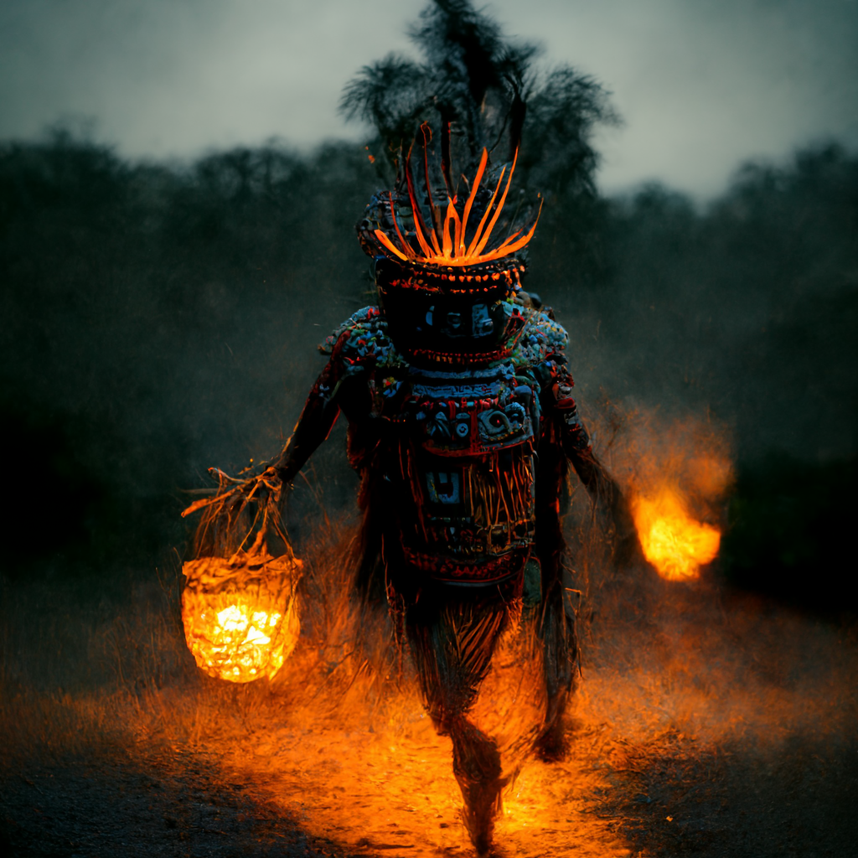
Then, just outside the Aztec capital of Tenochtitlan, high priests gathered at the summit of the sacred volcanic mountain south-east of Lake Tetzcoco, Mt. Uixachtecatl (also referred to as Huixachtlan or Citlaltepec and meaning 'thorn tree place', even if it is now called 'Hill of the Star'). The priests were magnificently dressed as the gods with fine cloaks, masks, and feather headdresses and led by the figure of Quetzalcoatl. Here, on a platform visible to the whole city below, the priests waited until midnight and a precise alignment of the stars which would signal the ceremony could begin. When the Tianquiztli (the Pleiades) reached their zenith and the Yohualtecuhtli star shone brightly in the very centre of the night sky, this was the moment a human sacrifice was made. The High Priest, probably dressed as Xuihtecuhtli and wearing a turquoise mask, cut out the heart from the living victim and a fire was kindled in the empty chest cavity using the sacred firestick drill, the tlequauitl. If the fire burned brightly, then all was well and Xiuhtecuhtli had blessed the people with another sun. If the fire did not catch, then the Tzitzimime would come without pity. These terrible monsters, armed with wickedly sharp knives, would roam the dark and sunless earth slashing and eating all humanity without exception. The world would end.

Slide 19
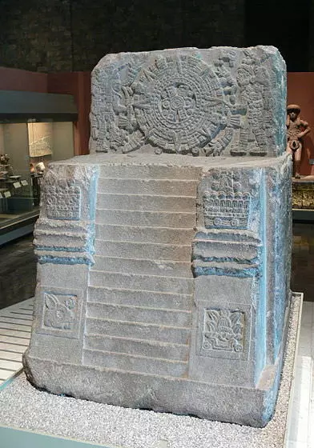
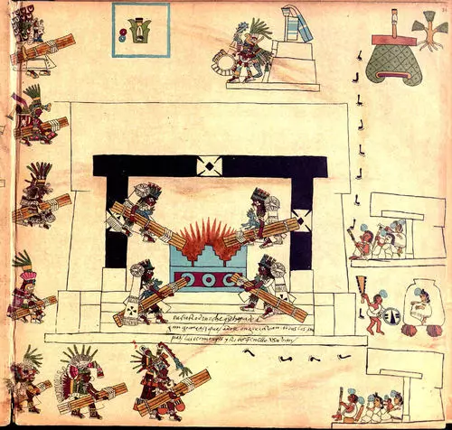
Thereupon, as the fire was being blessed, waiting Indians from many towns carried new fire to their temples. They did this after asking permission from the great chief of Mexico [Motecuhzoma], the pontiff who was, as it were, their pope. They performed this with great zeal and haste. Although the place might be many leagues away, they went in such haste that in a short time they placed the fire there. In the provinces distant from Mexico they performed the same ceremony and it was done everywhere with much feasting and rejoicing.

Slide 20
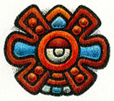
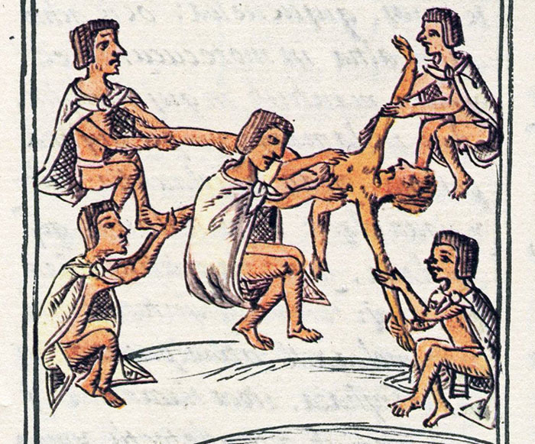
Notes:
Throne of Motecuhzoma II
Wolfgang Sauber (CC BY-SA)
One of the most famous of all Aztec

